Slide 1
Civil Rights Investigation into Minneapolis Police Department
Audel Shokohzadeh| Community Engagement Director
Slide photo by Unknown Author is licensed under CC BY-SA
Notes:
Hello everyone, thank you for joining me today for an overview of the Minnesota Department of Human Rights civil rights investigation into the Minneapolis Police Department.
My name is Audel Shokohzadeh, and I am the Community Engagement Director for the Minnesota Department of Human Rights. As the Community Engagement Director, I help lead education, outreach, and engagement efforts.
Today, I will be providing an overview of our civil rights investigation into the Minneapolis Police Department. The information I am sharing today is publicly available and has been shared by our agency. Given how busy our lives are we also wanted to make sure we pulled all that information together into the presentation today.
My presentation will take about 20 minutes. Afterwards I am happy to answer questions or hear any comments. I will first start by providing a brief overview of our department.

Slide 2
Building a Thriving Minnesota
Our vision: Create a world where everyone can lead lives full of dignity and joy.
Our mission: Make Minnesota discrimination free.
Our goals:
Create a more equitable Minnesota.
Create a more inclusive culture.
Identify and eliminate discrimination.
Notes:
The Minnesota Department of Human Rights is the state's civil rights enforcement agency. We strive to ensure everyone in Minnesota can lead full lives, rich with dignity and joy. And our mission is to make Minnesota discrimination free by creating a more equitable Minnesota, create a more inclusive culture, and identify and eliminate discrimination.

Slide 3
Minnesota Department of Human Rights
Minnesota Department of Human Rights
We are the state’s civil rights enforcement agency.
We are charged with upholding the civil rights of all Minnesotans under the Minnesota Human Rights Act.
Our civil rights laws prohibits discrimination on the basis of all protected class statuses, including race.
“Discrimination threatens the rights and privileges of the inhabitants of this state and menaces the institutions and foundations of democracy.” – Minnesota Human Rights Act
Notes:
Minnesota has one of the strongest civil rights laws known as the Minnesota Human Rights act.
Most of the cases that we work on is employment cases, though we also see a lot of housing cases as well. Most of our cases fall into either race, disability discrimination, or sexual harassment.

Slide 4
Setting the Stage
Focus on Department of Human Rights Investigation into City of Minneapolis
Active Investigation
Prioritizing Outreach
Notes:
Setting the stage
Before I continue, I want to note some things.
First, this presentation will focus only on the Department of Human Rights investigation into the Minneapolis Police Department. Our agency is not involved in the criminal case. The Attorney General lead the criminal case. We also receive lots of questions about state statues, the post board, charter amendments and the union. All of these issues are important and interrelated, and not the focus of the Minnesota Department of Human Rights Investigation.
Second, our investigation is still active. Ordinarily, the Department of Human Rights does not disclose any information about an investigation until it is complete. Due to the unprecedented nature of this case, we have shared some updates. But there may be some questions that I am unable to answer, and I will apologize now for that. if I am unable to provide an answer, it is to ensure the integrity of the investigation, and I appreciate your understanding.
Third, I also want to acknowledge that the investigation we are doing now would not be possible if not for the decades of work from community members that continue to fight for structural change. MDHR is working intentionally and thoughtfully to center and prioritize outreach within community to provide information about why we launched a civil rights investigation into the Minneapolis Police Department, how folks can provide information, and, of course, doing a whole lot of listening and learning.
To that end, we have been meeting with a whole lot of folks, everyone from the African American Leadership Forum, Children’s Defense Fund, CTUL, HACER, ISAIAH, Jewish Community Action, Minneapolis Chamber of Commerce, Pillsbury United Communities, and so so many more folks. We want to make sure we are sharing as much as possible when possible and learning and listening all the time.

Slide 5
Investigation Timeline (1)
June 2
Notes:
Now, onto the investigation timeline. We will start with June 2.

Slide 6
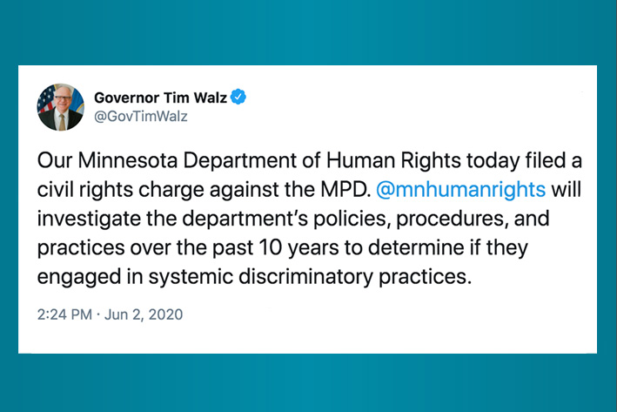
June 2: Announcement
Notes:
On June 2, 2020, Governor Walz and Lt. Governor Flanagan, and Human Rights Commissioner Rebeca Lucero announced that the Minnesota Department of Human Rights would begin an investigation into the Minneapolis Police Department after filing a civil rights charge.
Minnesota has one of the strongest civil rights laws in the country. And it is illegal for a police department to discriminate against anyone because of their race.
The charge alleges the killing of George Floyd, an unarmed Black man, while in the custody of Minneapolis police officers may be evidence of a broader pattern and practice of race-based policing in violation of the state's civil rights law.
This is the first time the state has launched a civil rights investigation into the patterns and practices of the largest police department in the state.
Our investigation into whether the Minneapolis Police Department engaged in unlawful discrimination based on race is just one piece of a broader public conversation around public safety and ending discrimination in our communities.

Slide 7
Investigation Timeline (2)
June 2
June 5
Notes:
On June 5, we filed an emergency court action with details on immediate structural changes the MPD must implement.

Slide 8
June 5: Proposed Court Order
Notes:
The City of Minneapolis agreed to the structural changes and joined us in submitting the proposed court order. Under the order:
Chokeholds and neck restraints are immediately banned;
Police officers must report and actively intervene if another officer utilizes an unauthorized use of force;
The use of crowd control measures and weapons during protests and demonstrations may only be approved by the Chief of Police or their designee;
Timely and transparent discipline decisions for police officers must be made; and
The Minneapolis Civil Rights Department may audit body camera footage.

Slide 9
Investigation Timeline (3)
June 2
June 5
June 8
Notes:
A few days later, the Hennepin County Court approved and entered the proposed court order, and the court has the power to enforce these preliminary measures. Failure to comply with the order could lead to penalties.

Slide 10
June 8: Approved Court Order
Notes:
Some of you may recognize the measures in the court order are similar orders enforced in Chicago, Baltimore, and Ferguson. Those court orders took months to develop and implement.
We were able to implement a court order mandating immediate change within a week of starting an investigation because of the tireless work of community organizers and leaders demanding change and an understanding by leaders in the City and Police Department that these were the first steps needed for structural change.
As stated in the court order granting our temporary restraining order, “Black, Indigenous, and communities of color have suffered generational pain and trauma as a result of systemic and institutional racism and long-standing policies in policing. This continuous harm was once again highlighted by the in-custody death of George Floyd.”

Slide 11
Today: Heart of the Investigation
MDHR’s team of neutral investors is actively reviewing ten years of information. Some examples include:
Stops
Searches
Arrests
Use of Force
Policies
Procedures
Trainings
Interviews
Ride-alongs
Notes:
Today, our team of neutral investigators is continuing to review ten years' worth of data and information. The involves reviewing data, policies, procedures, and interviews with current and former officers, chiefs of police, and city officials, and participating in ride along in every precinct.

Slide 12
Today
To share any positive, negative, or neutral experience with the Minneapolis Police Department you can contact us over the phone or online.
Translations and interpreters are available over the phone, and the online form is available in English, Hmong, Somali, and Spanish.
The last day to share information is Tuesday, December 15, 2020.
651-539-1100
mn.gov/mdhr/
Notes:
We have also heard from hundreds of individuals that have shared their experience with the Minneapolis Police Department with us.
Community members are invited to call MDHR at 651-539-1100 or fill out a survey on the website at mn.gov/mdhr to speak to an investigator on their positive, neutral, and negative experiences with the MPD. Translations and interpreters are available over the phone, and the survey is available in English, Hmong, Somali, and Spanish.
The last day to share information is Tuesday, December 15, 2020.

Slide 13
Common Questions
What is the likely timeline for the investigation to conclude?
Can you provide feedback on [insert something outside of the scope of the investigation]?
What is MDHR’s likely outcome and next steps?
Will you make your investigation public?
Notes:
Q1: The timeline depends on how easy it is to gather information, what we find during the investigation, and the community engagement process.
Q2: Can you provide feedback on [state statues, the post board, charter amendments and the union]? All of these issues are important and interrelated, and not the focus of the Minnesota Department of Human Rights Investigation.
Q3: The investigation is still ongoing. At the end, we will either determine if discrimination occurred. If we find that discrimination did not occur, our work with the City of Minneapolis and the Minneapolis Police Department concludes. If we find that discrimination occurred, we will work with the City of Minneapolis and the Minneapolis Police Department to change policies and procedures. A consent decree is a legal tool that can be used for systems change that the court has oversight over. Cities such as Ferguson, Baltimore, and Chicago have entered into consent decrees in similar circumstances.
Q4: Yes, we will make our determination public and our goal is to be as transparent as possible.

Slide 14
Online Resources
Visit: https://mn.gov/mdhr/mpd/ to access frequently asked questions, legal documents, and more.

Slide 15
Thank you!
Notes:
I want to thank you all for taking the time to join me today as I provided this overview of our investigation to date. I now welcome an opportunity to answer questions and hear your thoughts.

